Slide 1
Campus Clubs
N-Tiered 2 Semester Project by Juan Andujar & Patrick Kelly

Slide 2
Abstract
Campus Clubs is a website that will make it easier for students to keep track and view their club. Students will be capable of adding clubs they are interested in through tags along with the capability of creating a club.
Students will also be capable managing their club e-board, member list, meeting times, and even update their club page.

Slide 3
Web Pages
Home
Login
Signup
Interests
Club List
Add Club
Request Page
About Page
Club Page
Club Edit Page

Slide 4
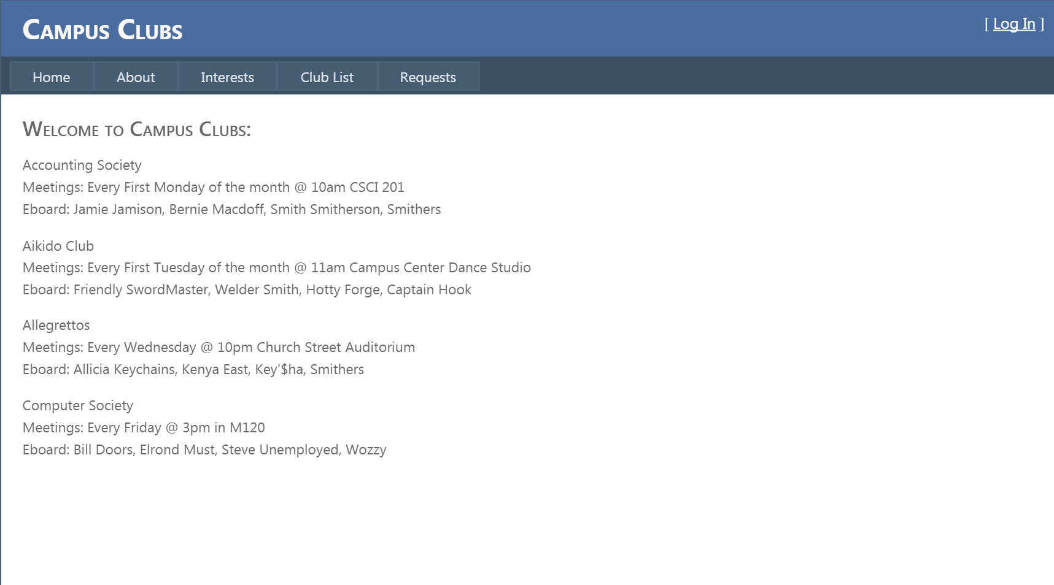
Home Page
The home page will include an overview of all of the clubs on CampusClubs.com.
It will essentially be a show case for all clubs to show their information(name, meeting time, eboard list).

Slide 5
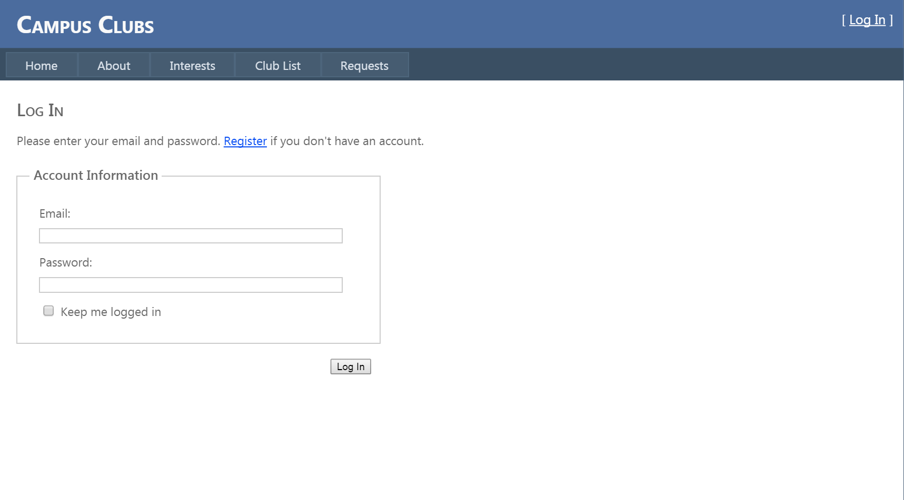
Login Page
This will be a page where the user will be capable of login in using their email address and password as credentials.

Slide 6
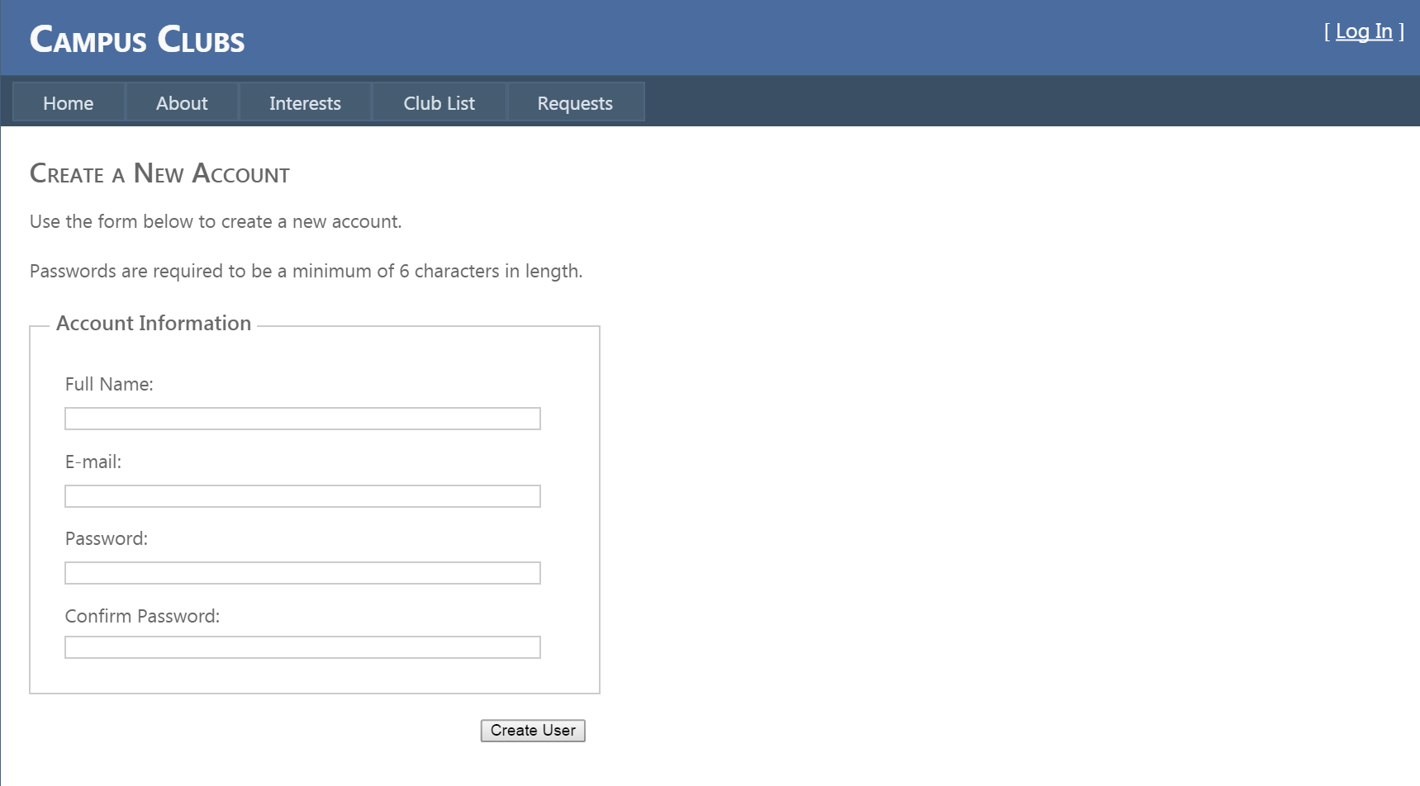
Signup Page
This page will allow the user to create a profile on CampusClubs.

Slide 7
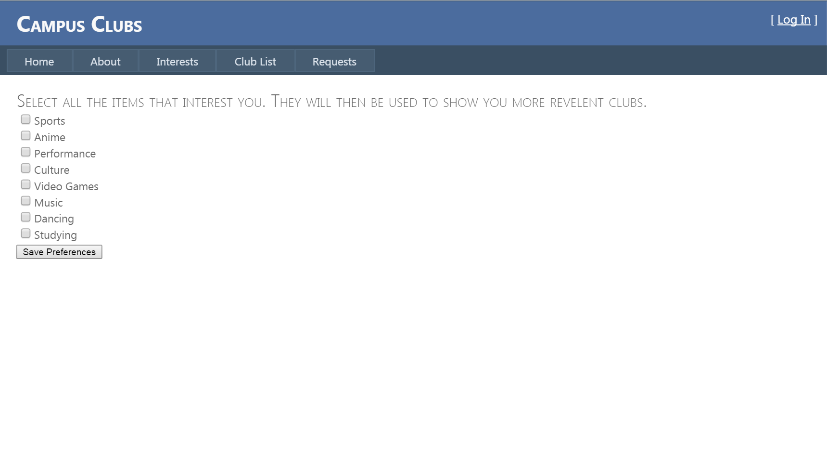
Interests Page
The interests page is where students will be capable of choosing their interests. Club interest tags will be used to create a personalized club list page.
Some tags include sports, videogames, music, dancing, studying, etc.
These tags will make it even easier for students to figure out what clubs they want to be a part of relative to their personal interests.

Slide 8
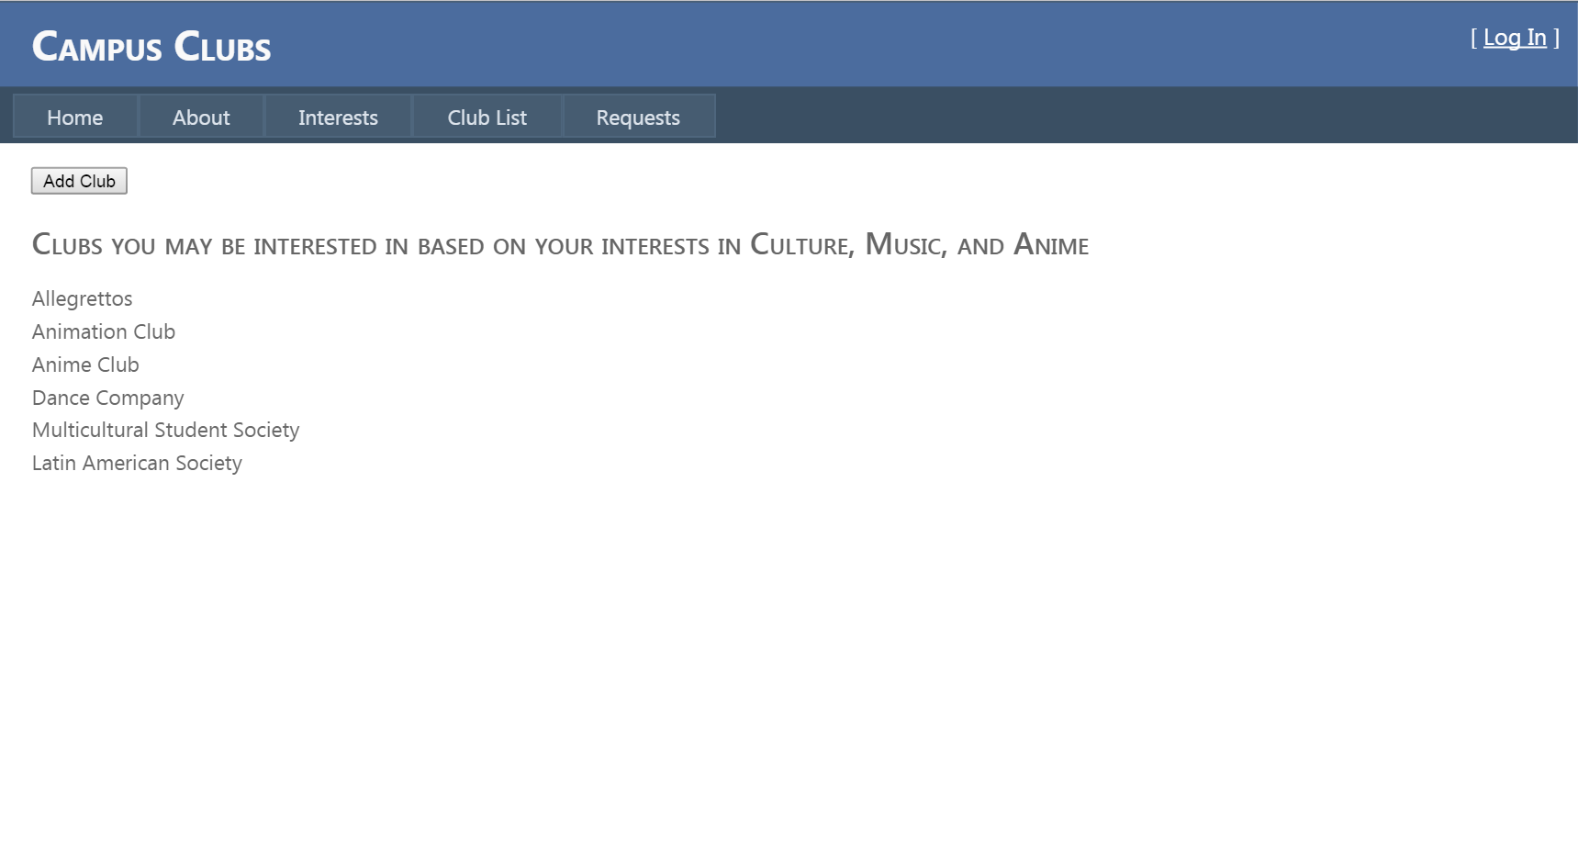
Club List Page
The club list page will contain all of the clubs a student picks based on their interests. It is would be subjectively catered to each students clubs they have chosen based on the decisions made on the interests page.

Slide 9
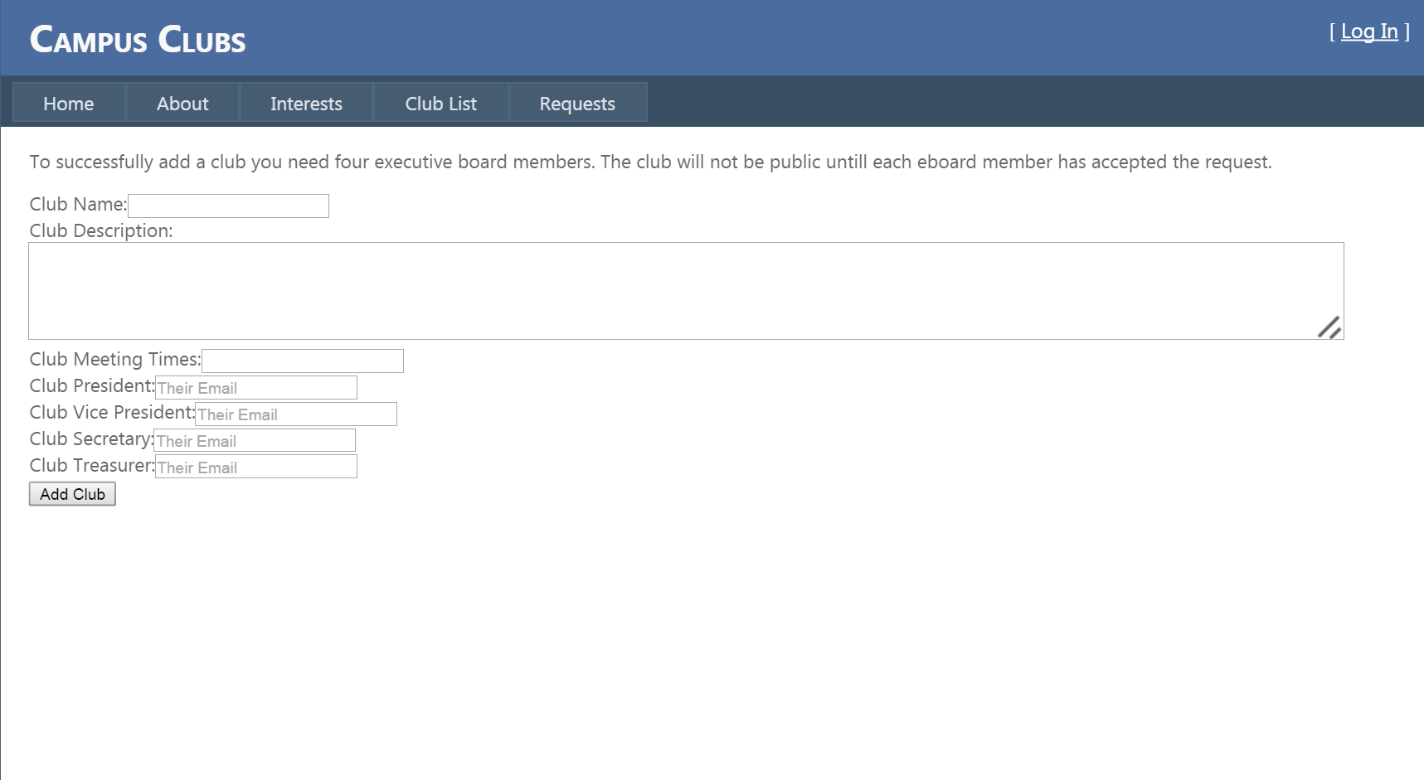
Add Club Page
This page will allow the user to create a club. Clubs are truly not in effect until all executive members have accepted invites into the club their being invited into.
Clubs consist of a name, description, e-board members, meeting times, and a description.
If the creator of the club does not have all of their executive members accept their request page, the club will be deemed private on Campus Clubs until all members accept their requests.

Slide 10
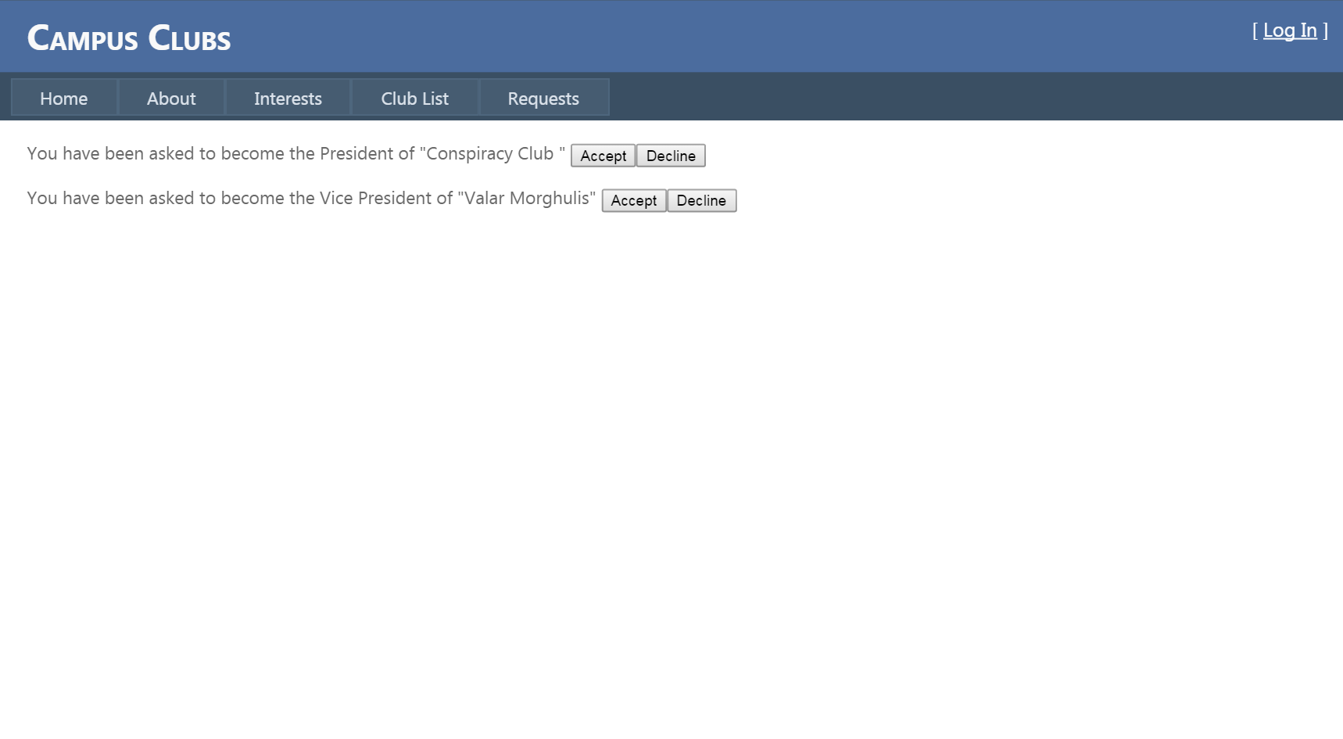
Request Page
The request page is a part of the add club page. It allows us to confirm an executive member into a club.
Once an executive member accepts the club invite through their request page, they will be a part of the club.
All E-board members of a club must accept club invites on the request page in order to successfully create a club.

Slide 11
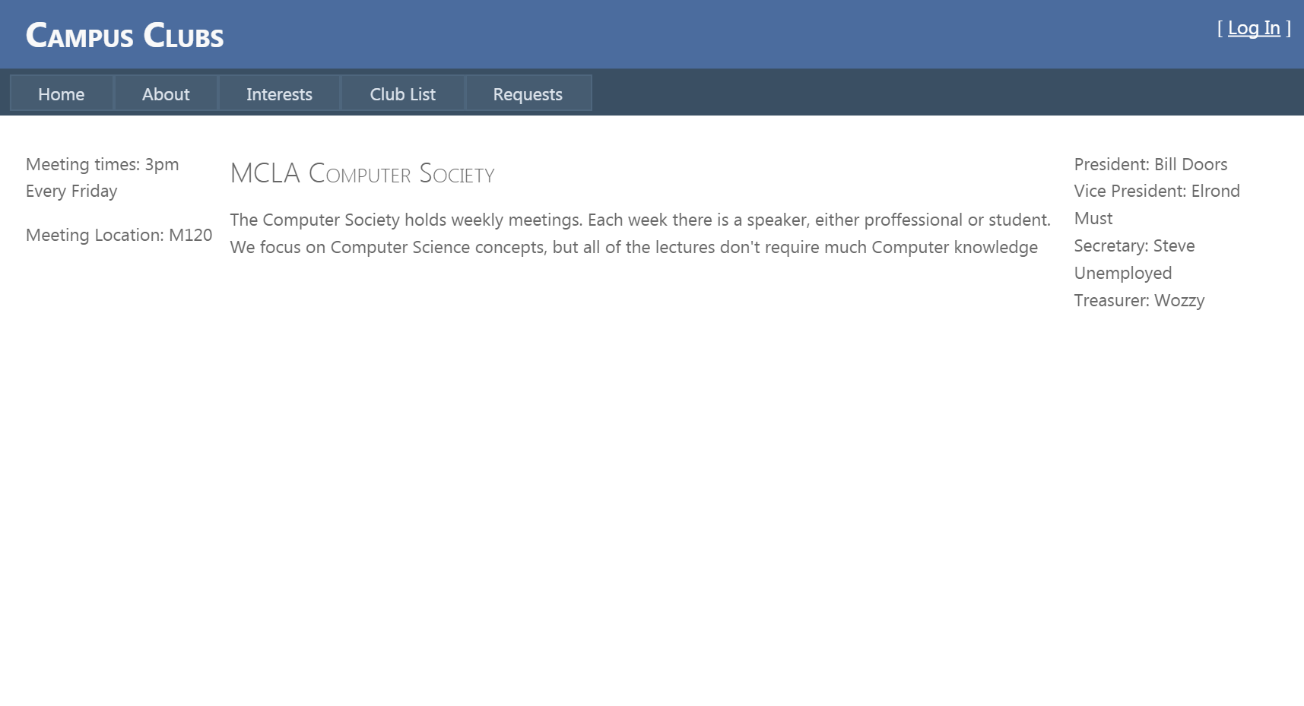
Club Page
The club page contains all of the information regarded towards a specified club.
Here the user will be capable of viewing the active executive board and member roster, meeting times of the club, and even a description of the clubs.

Slide 12
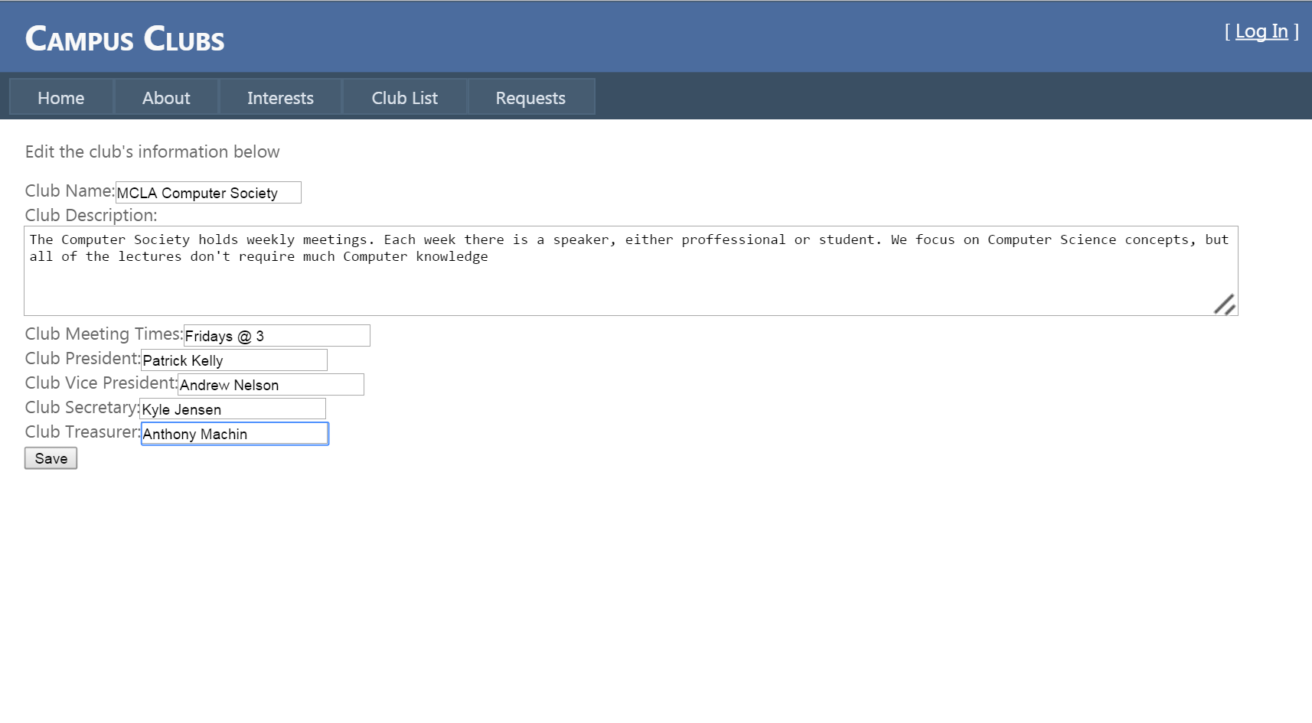
Club Edit Page
This page is a part of the club page which will allow executive members to edit the current club page.
Here executive members can update their executive board, members, club meeting times, and descriptions of the club.

Slide 13
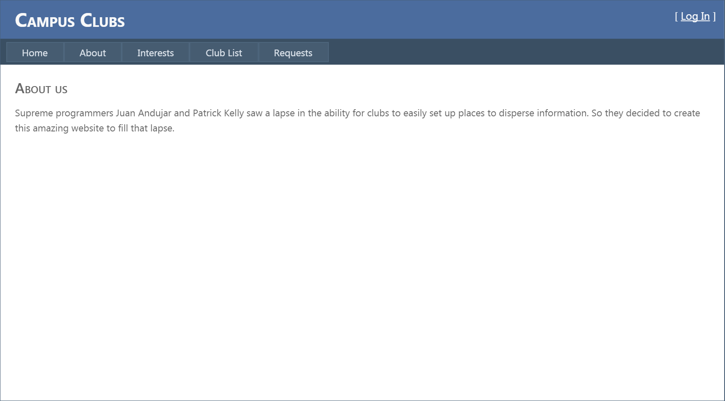
About Page
The about page will contain a brief description of Campus Clubs developers along with our primary focus of this website.

Slide 14
Main focus of Campus Clubs
The point of this website is to centralize and facilitate club interaction amongst executive members, students already in clubs, and even newcomers as well.
Having one place for all campus club organizations will also provide a greater level of cohesion and understanding about each club.

